Slide 1
Map Generator
Lynn Farrington
Project Proposal
CS 240 Spring 2019

Slide 2
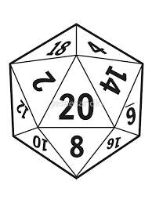
Roleplay Games
Co-operative story-telling
Dungeon Master (or Game Master) is responsible for setting up the environment, non-player characters, obstacles and rewards.
Players are responsible for creating their own characters.
And the dice introduce the random element.

Slide 3
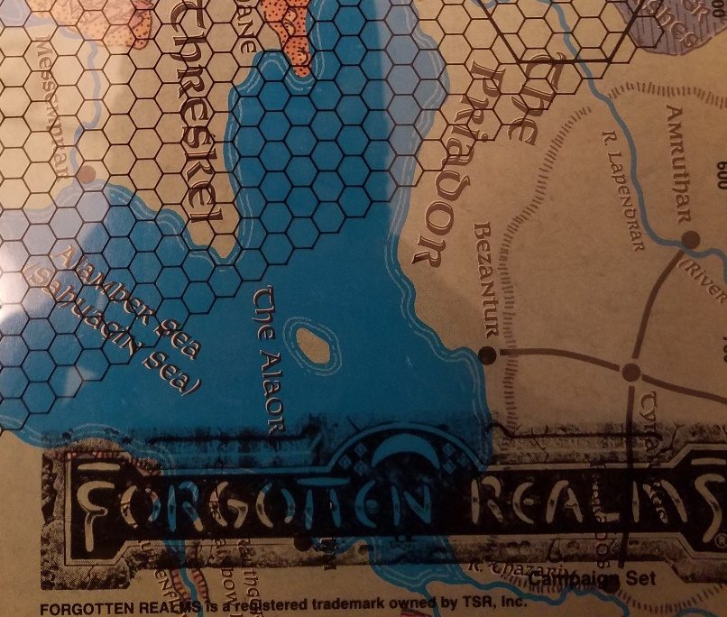
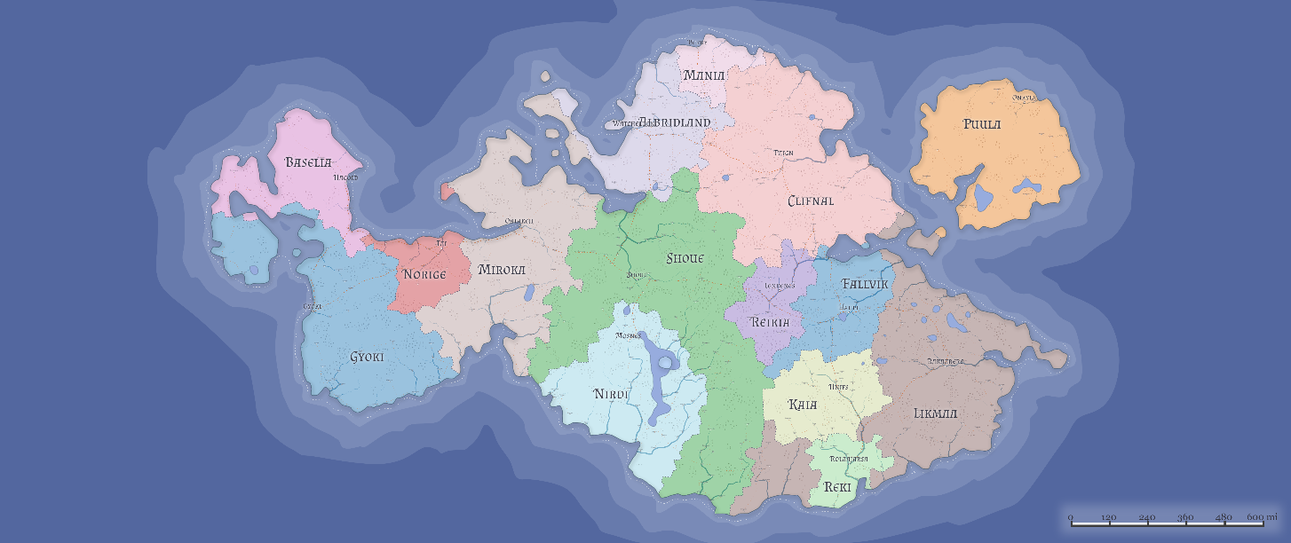
Maps
Maps may include locations of monsters, treasure or traps along with more typical items like towns, caverns, or buildings.
DM creates maps prior to gameplay, some are shared with players, some are held back for the players to discover.
Players often draw maps as they explore, or are given additional maps throughout the adventure.

Slide 4
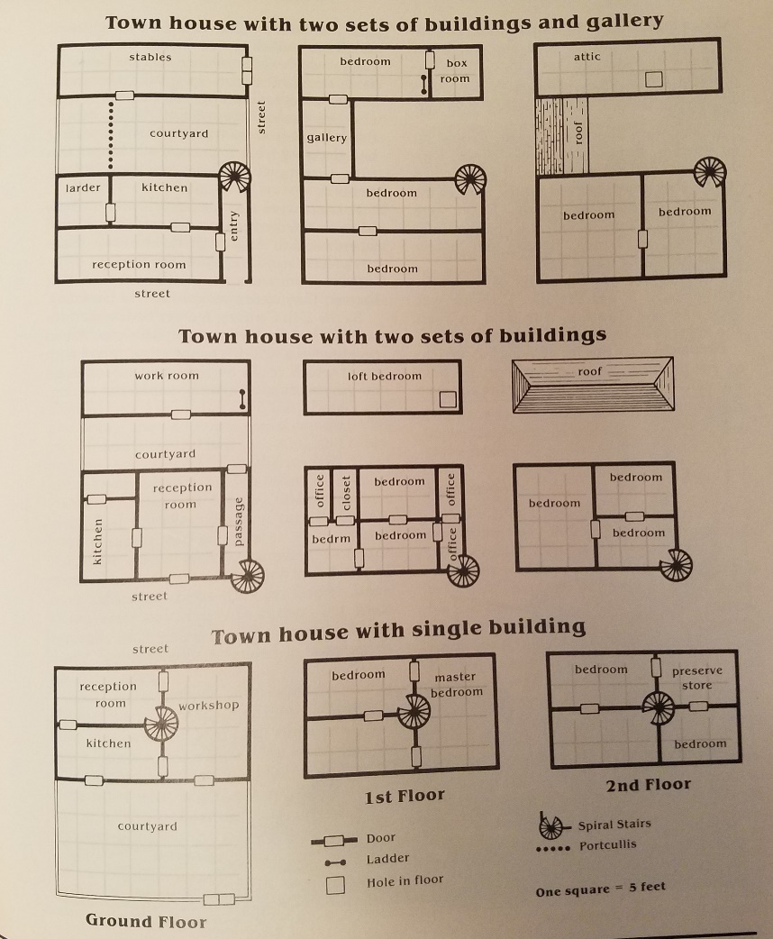
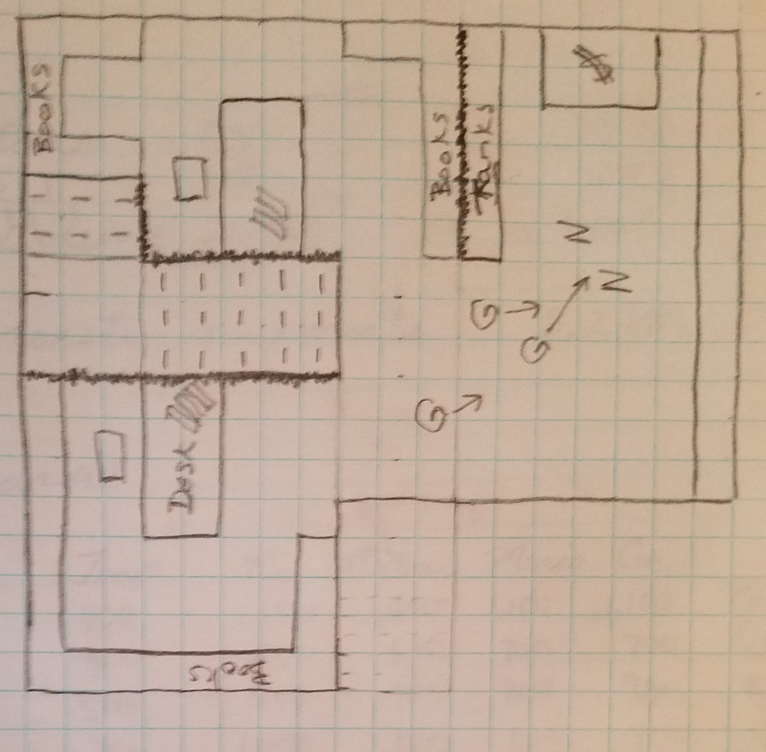
Is the indoor map a castle, a farmhouse, a barracks, a smithy, or maybe the common room of a questionable inn?

Slide 5
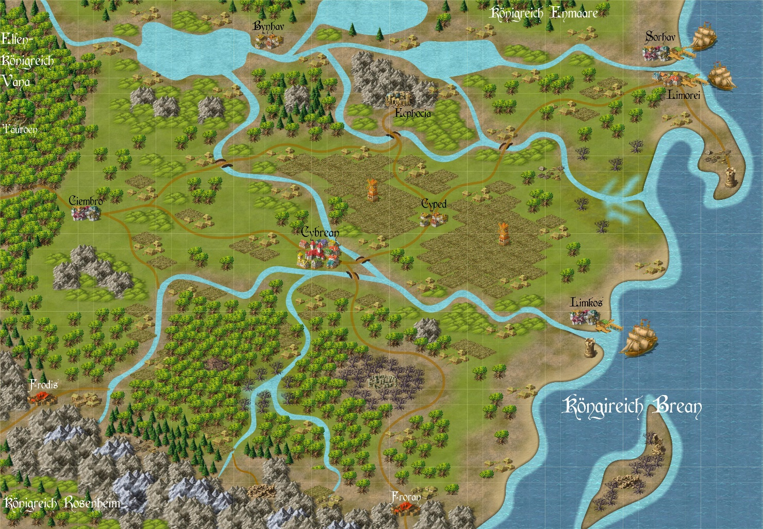
Is the outdoor map a town, a forest, or a treacherous pass through enemy held mountains?

Slide 6
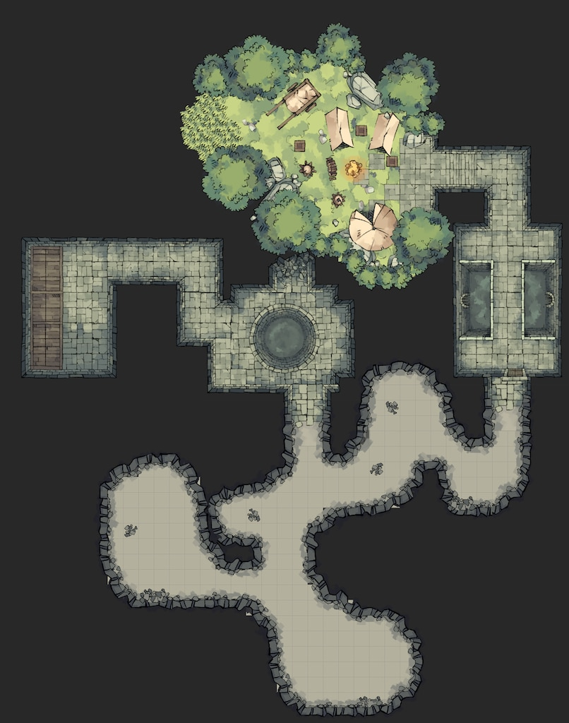
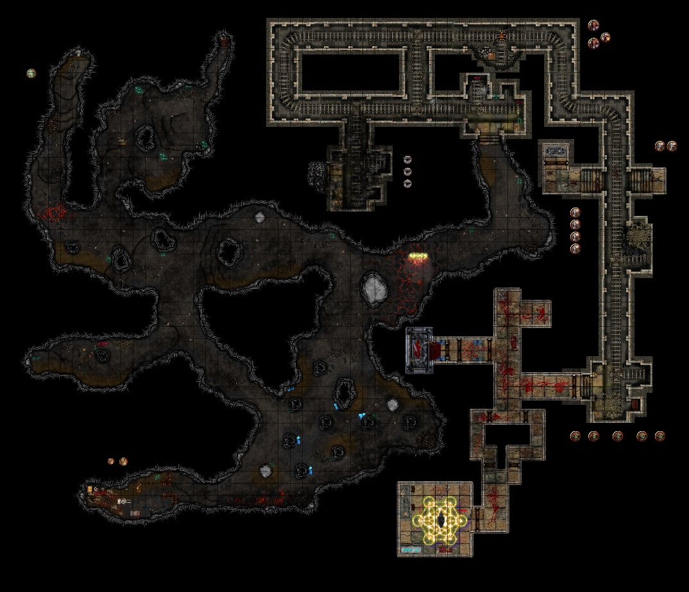
Is the subterranean map natural caverns, a mine, a crypt, a dwarven or drow village, or even a secret passage?

Slide 7
Map generator could either allow user to craft a map by providing grid and textures, or be more automated, where user would select, indoor, ruins, large, 3 floors, 10 rooms and the program would generate a map to match request. We could also allow the user to generate treasure listings, planned and random encounters, traps, etc.

